Slide 1
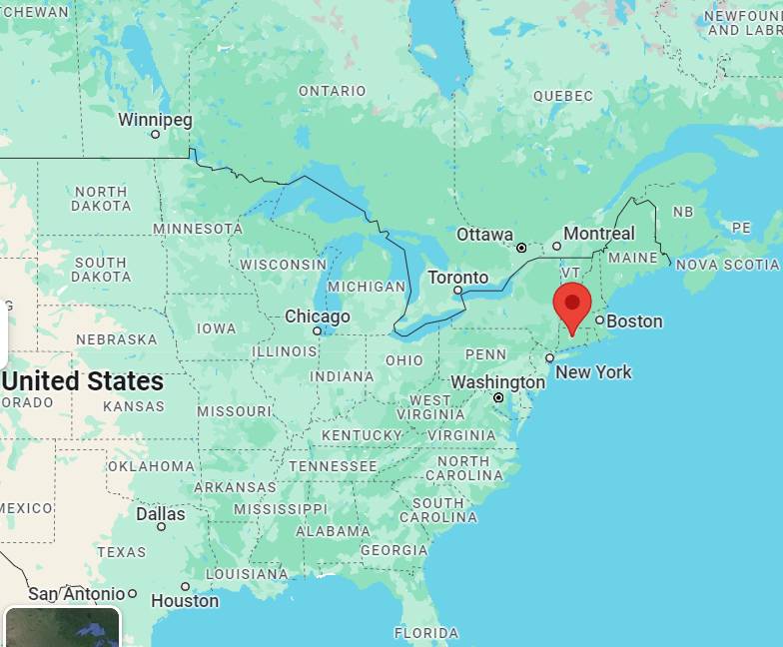
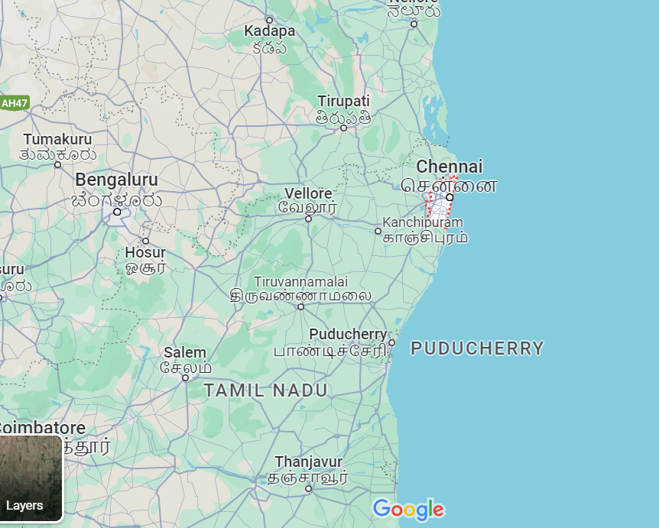
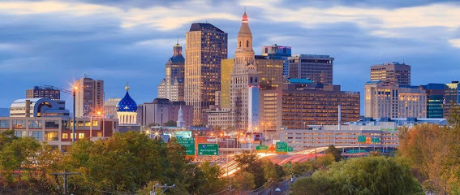
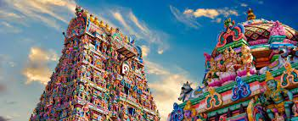
Kanika jindal
Jaipur, Rajasthan
Fun fact about this place – Walls of this city painted in pink. So its called pink city.
Place picture of map & picture of the place

Slide 2
My favorite hobbies
My favorite food
Insert pictures to make it fun

